Slide 1
WISCAT
Vickie Long, WISCAT Outreach & Technical Support
Manitowoc Calumet Library System
17 November 2011

Slide 2
Patron-Initiated Requesting
Considerations
Make available to some or all patrons?
Individual user accounts or generic (guest)?
Mediated or unmediated requesting?
Functionality
ILL request tracking
Patron Email notification
Option to make Library Card required in ILL request
Instruction
Staff training
Guides to customize for patron use

Slide 3
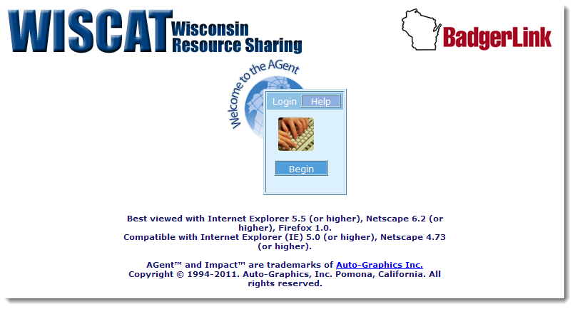
Open Requesting
OPTION 1:

Slide 4
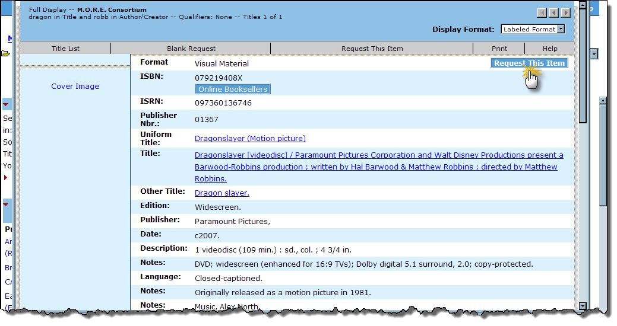
Allow Request Submission
Notes:
• Patron Groups lets you create one or more groups to which users may be assigned for accessing
resources. Access to specific resources can be limited to only those users associated with a given group.
Linking Resources to Patron Groups is accomplished through the PAC Administration module.

Slide 5
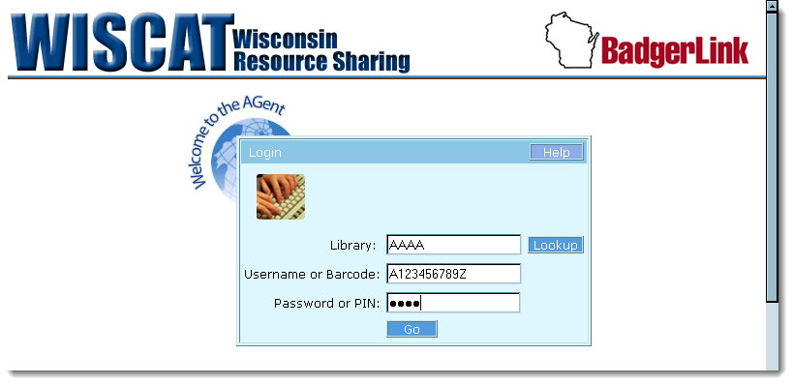
Login Requesting
OPTION 2:

Slide 6
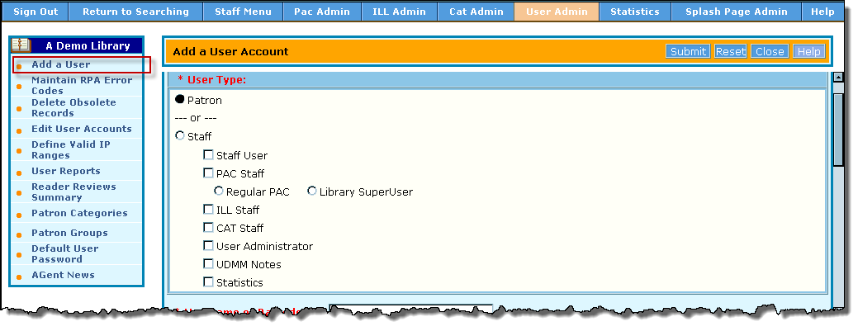
Staff creates Individual Patron Accounts

Slide 7
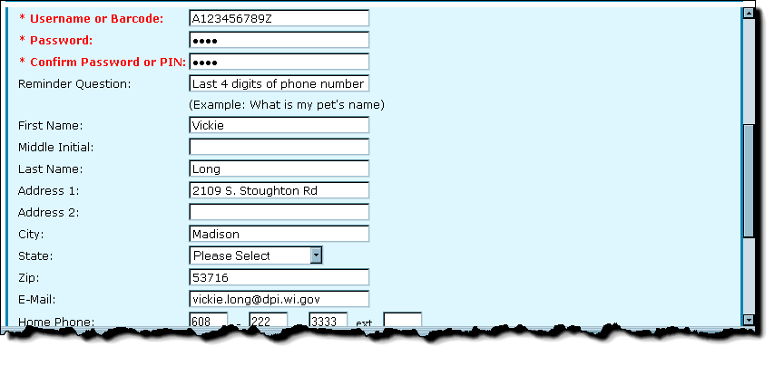
Individual Patron Account

Slide 8
Individual Patron Account

Slide 9
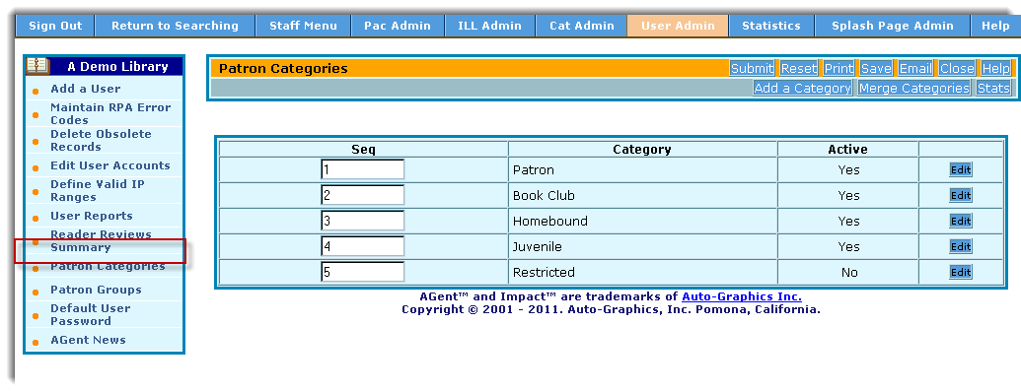
Patron Categories - optional
Notes:
Patron Categories is an optional feature used with ILL request Limits. Using Patron Categories, you
can create one or more categories to which patrons may be assigned. Each category is designated an
“ILL Request Limit” (the maximum number of active ILL Requests allowed for a patron assigned to
the category) through the ILL Administration module. Library patrons are assigned to Patron
Categories through the User Administration module.

Slide 10
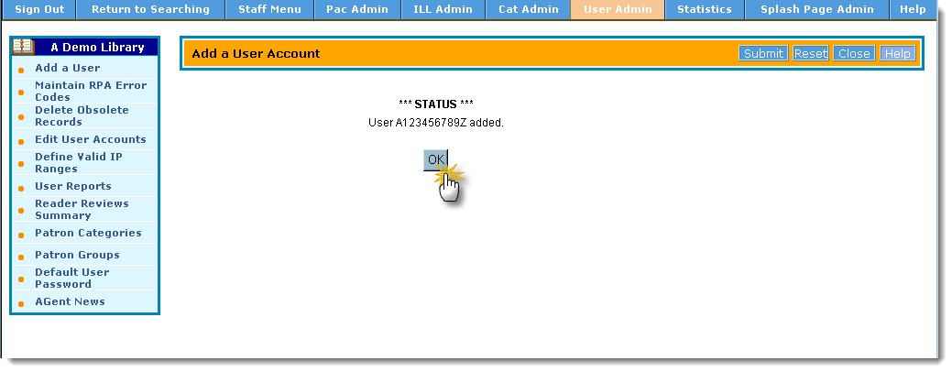
Individual Patron Account

Slide 11
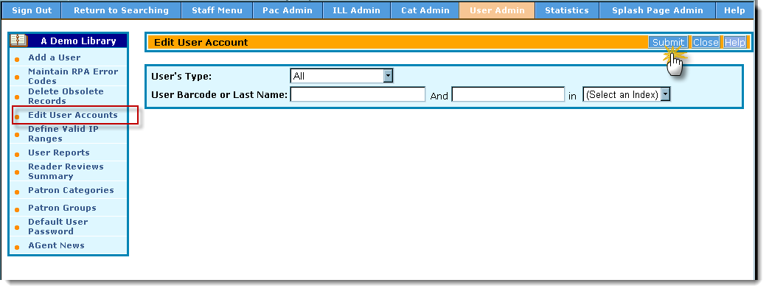
Edit User Accounts

Slide 12
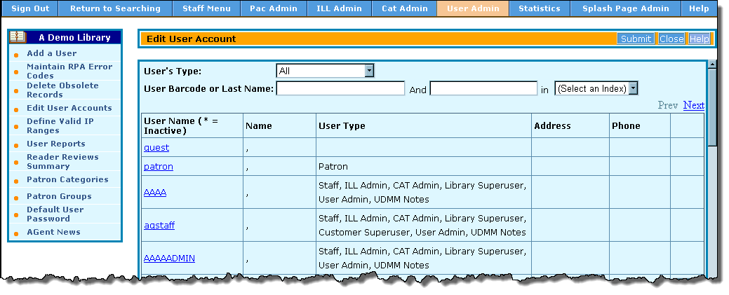
Find New User Account

Slide 13
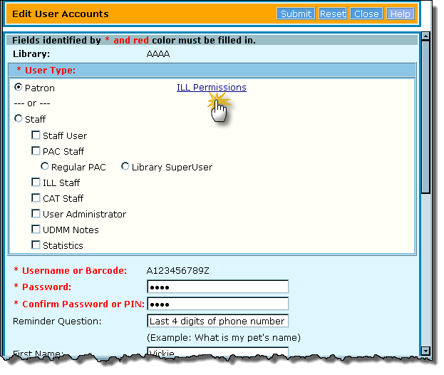
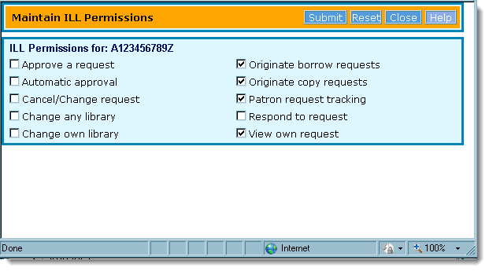
Assign Patron ILL Permissions

Slide 14
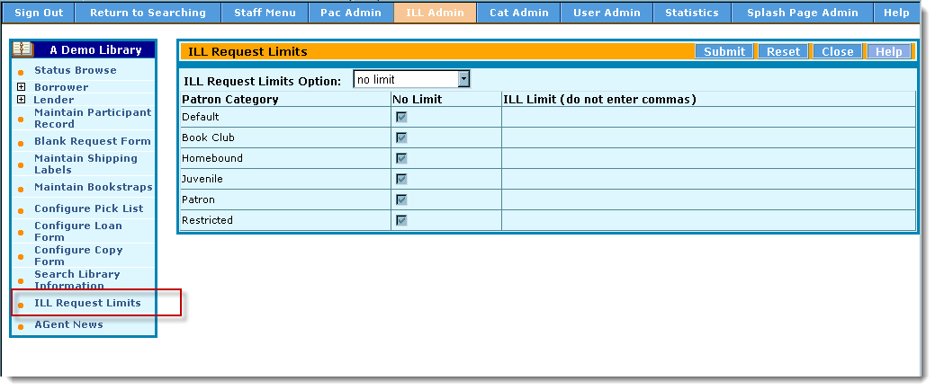
May Set ILL Request Limits

Slide 15
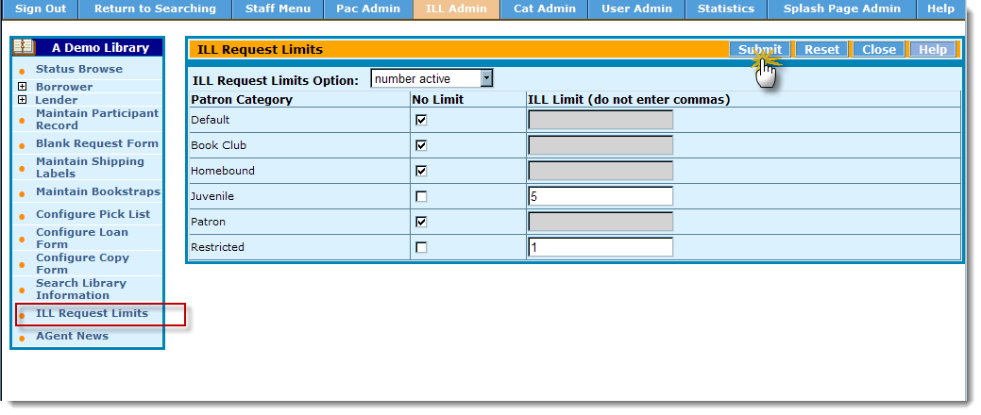
ILL Request Limits -- Options

Slide 16
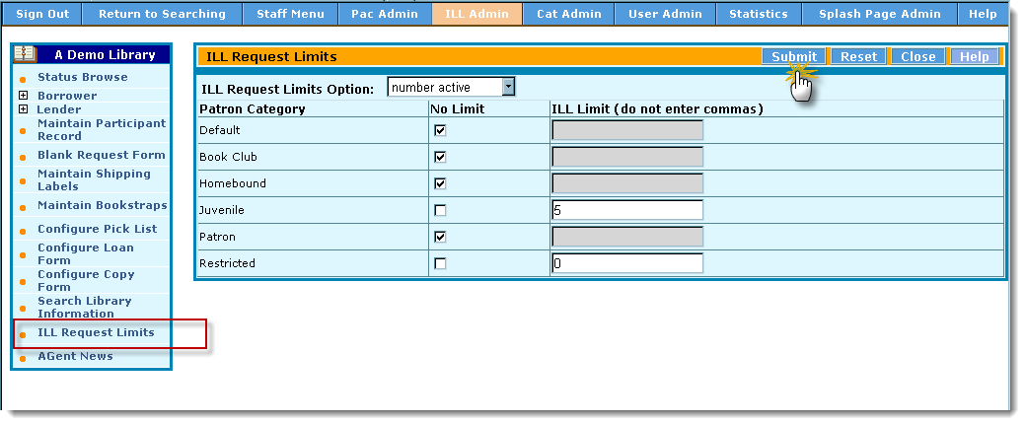
Set ILL Request Limits

Slide 17
Patron Login

Slide 18
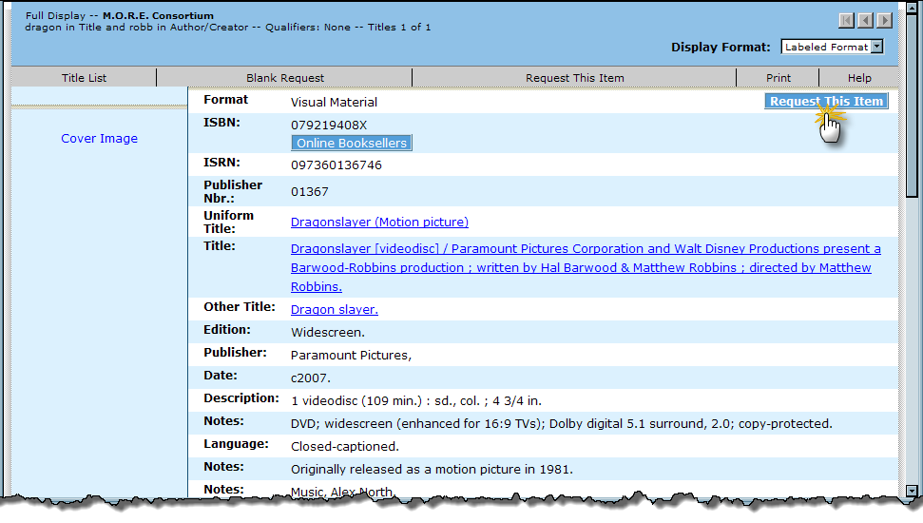
ILL Request

Slide 19
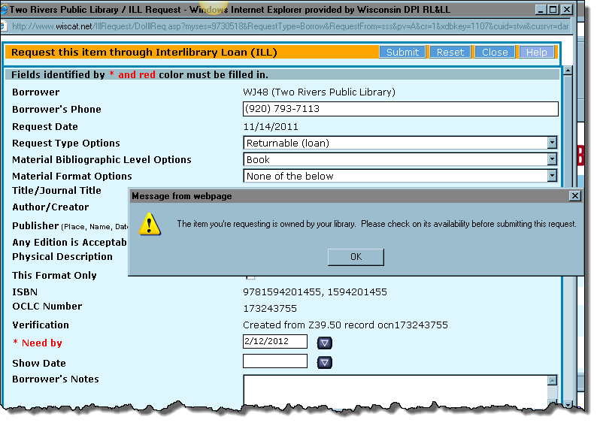
Your Library Owns

Slide 20
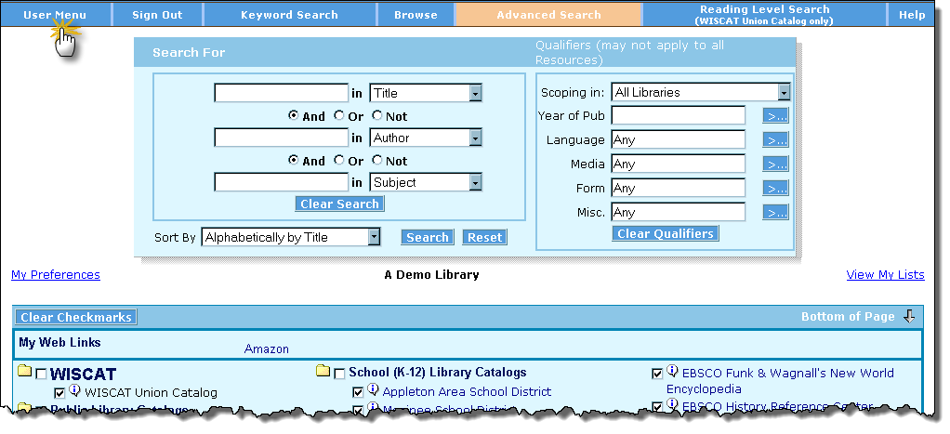
User Menu

Slide 21
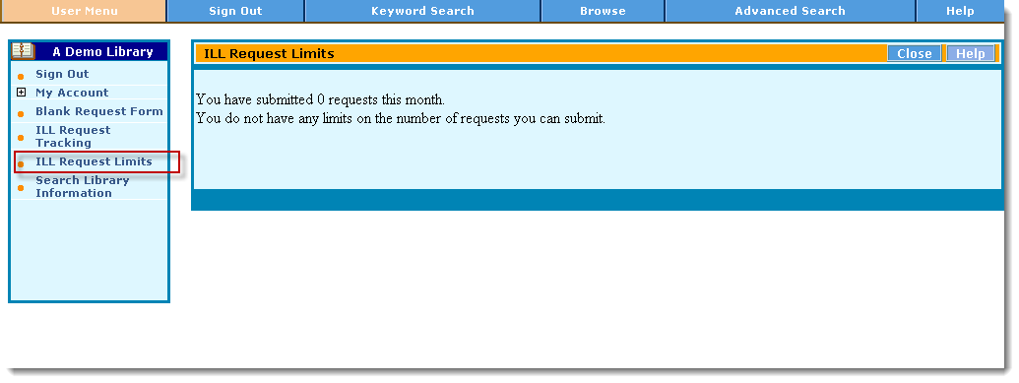
ILL Request Limits

Slide 22
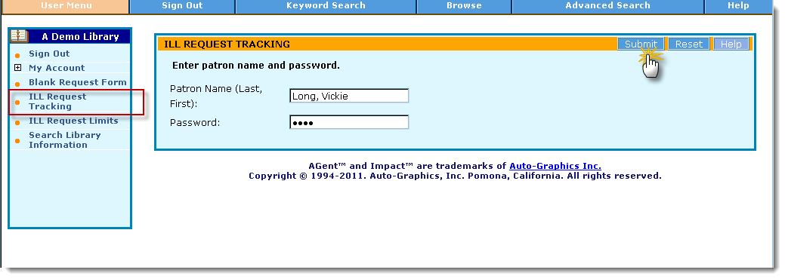
ILL Request Tracking

Slide 23
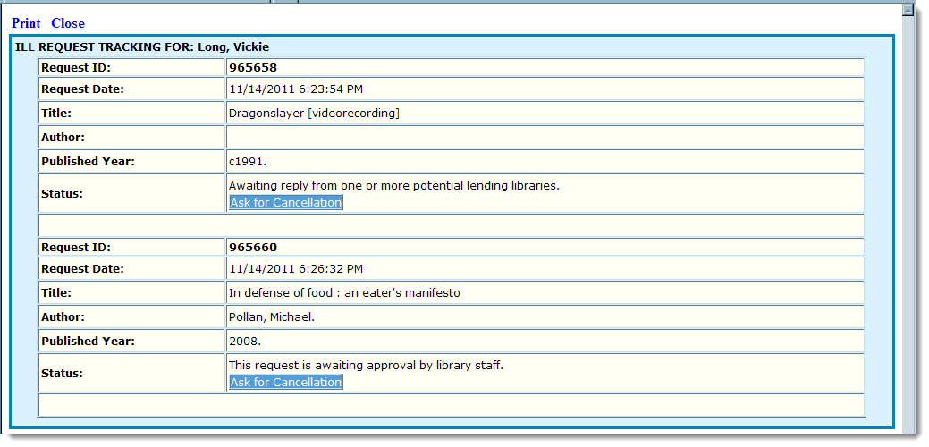
ILL Request Tracking

Slide 24
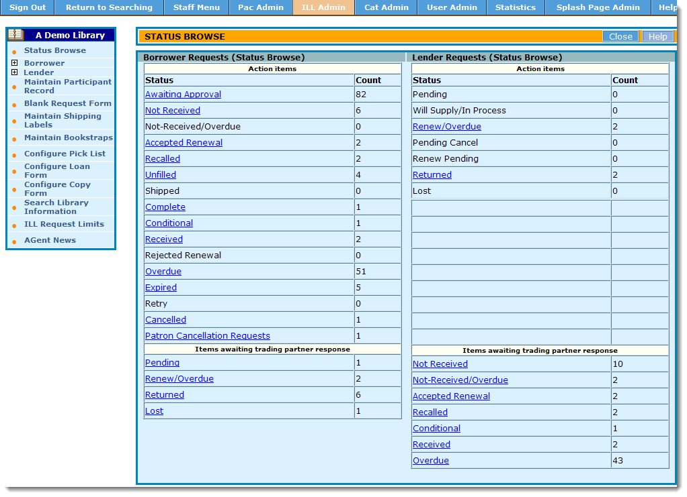
Patron Requests -- Mediated
All patron requests await approval

Slide 25
Contact Info
Vickie Long, WISCAT Outreach & Technical Support Resources for Libraries & Lifelong Learning (RL&LL) Wisconsin Department of Public Instruction
(608) 224-5394 (voice) (888) 542-5543 ext 1 (toll free in WI) vickie.long@dpi.wi.gov
info about Patron Initiated Requesting on RL&LL website
http://www.dpi.wi.gov/rll/wiscat_ill_patron_initiated.html
Notes:
http://www.dpi.wi.gov/rll/wiscat_ill_patron_initiated.html

