Slide 1
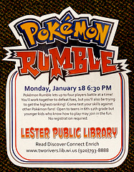
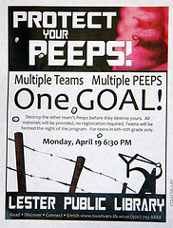
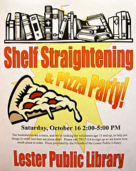
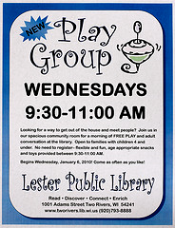
Marketing With PowerPoint
Friday, December 9 9:00 AM
PowerPoint 2010 can be more than presentation software. Lester Public Library’s Youth Services Coordinator Terry Ehle will demonstrate easy-to-create posters and photo-collages to market your library events. Learn some practical tips and tricks to working with photos, clip art, fonts and more! Whether intended for the Web or in-house, PowerPoint can help you accomplish your marketing goals.
This workshop is hands-on. Participants are encouraged to bring their laptop and to ask lots of questions. Terry will focus on PowerPoint 2010 but many of the tips can be done in earlier versions and in Publisher. This program is for anyone who needs to create posters, signs for displays and other marketing materials for their library.
Please register by calling Becky Petersen at (920) 553-6257 or email rpetersen@mcls.lib.wi.us by Friday, December 2.
Lester Public Library
1001 Adams St. Two Rivers, WI 54241 (920)793-8888 www.lesterlibrary.org

