Slide 1
The Library Board as employer
Wisconsin Library Association
November 3, 2011

Slide 2
Today we will discuss…..
Relationship to the Library Director
Personnel Policy for the Library
Library Board and other Library Staff

Slide 3
Relationship to the Library Director
Primary role:
Supervisor
*as the Board of Trustees, not as individuals

Slide 4
Library Board’s Supervisory Roles:
Hiring a new director
Evaluating the director
Firing the director when necessary

Slide 5
Hiring the Director

Slide 6
Hiring the Library Director
Appoint a search and screen committee
Include Board members, staff, community members

Slide 7
Hiring the Library Director
Review (and update) the job description
Make sure it accurately reflects duties

Slide 8
Hiring the Library Director
Creating the job ad
“Why would a talented director want to work for our library?”

Slide 9
Hiring the Library Director: Creating the job ad
Opening paragraph:
List 3-5 selling points about the position and the library
Specifics:
General scope of work
Work environment
Benefits available
Job requirements (education and experience)
How to apply and deadline for applications

Slide 10
Example of Selling Points
The Board of Trustees of the Public Library of Youngstown & Mahoning County, seeks a dynamic, articulate administrator skilled in communicating, listening and responding to lead the Library in providing quality programs and services for this culturally rich and diverse community of 229,000.
Entrepreneur magazine (2009) identified Youngstown/Mahoning County as one of the top 10 communities in the U.S. for starting a business. Forbes magazine (2011) called the metro area as "One of the Best Cities for Jobs" in the U.S.--adding to its earlier recognition as one of the "Best Bang for Your Buck" metro areas in the country.
Contributing to these accolades are young dynamic political leaders and thriving tech ventures like Turning Technologies (Inc. 5000). In addition Youngstown State University, a growing arts and cultural environment, a beautiful parks system and being one of the most affordable places in the nation to live and work make the County an attractive location.

Slide 11

Hiring the Director
Post the Job Ad
Library, City Hall
Online
    Library web site
    System web site
    WISPUBLIB
    LisJobs.com

Slide 12
Hiring the Library Director
Create a list of interview questions
Think about the most important skills your new director needs to have
Tailor questions to those skills
Open vs. Closed questions
Consult with City/Village Attorney or HR dept. to avoid legal pitfalls

Slide 13
What you should know:
State and Federal laws that prohibit discrimination in hiring
Title VII of the Civil Rights Act of 1964
Equal Pay Act of 1963
Age Discrimination in Employment Act of 1967
Title I and Title V of the Americans with Disabilities Act
Civil Rights Act of 1991

Slide 14
Hiring the Library Director
Reviews Applications
Looking for the “best fit”
Weed out unqualified applicants
Select candidates to interview

Slide 15
Hiring the Director
Conduct Interviews
Use the same set of pre-determined questions with every candidate

Slide 16
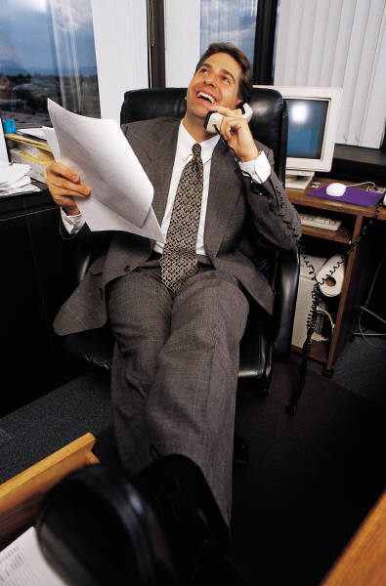
Hiring the Library Director
Check References
Go beyond just the references on the resume
Ask the same questions of each reference

Slide 17
Hiring the Library Director
Search & Screen Committee Recommends Candidate to Full Board for Approval
Confirm appointment and starting date in writing
Notify applicants not selected

Slide 18

Evaluating the Director

Slide 19
Evaluating the Director
Why?
To provide the director with formal
feedback on performance

Slide 20
Evaluating the Director
Who?
The Entire Board

Slide 21
Evaluating the Director
What?
The evaluation should be based on 3 factors:
The director’s performance as it relates to the job description.
A list of objectives from the preceding year jointly written and agreed upon by the director & the board.
The success of the library in providing service to the public and the director’s contribution to that success.

Slide 22
Evaluating the Director
When?
Once a Year
For New Directors:
3 months
6 months
1 year

Slide 23
Evaluating the Director: Tips for success
Be sure the director’s job description is up to date
Have clear expectations for performance
Deal with performance issues right away, don’t wait until a formal evaluation!
Consider outside factors that may be influencing performance

Slide 24
Firing the Director

Slide 25
Firing the Library Director
Have an established, systematic and documented procedure in place for how the library deals with discipline and termination issues.
Communicate performance issue to the director and discuss actions needed to correct the problem
Document performance issue(s) and steps taken to address the issue. Escalate actions per the disciplinary procedure
Get legal advice before terminating the director

Slide 26
Having a successful working relationship requires:
Mutual Respect
Clear, open communication
Professional behavior -- “What happens in the board meeting, stays in the board meeting.”

Slide 27
Library Board as Employer
Personnel Policies

Slide 28

Personnel Policies
Describes the relationship
between
management and employees

Slide 29
Personnel Policies establish:
General employment information
    “At will” status
    Employee status definitions: full-time, part-time, exempt, non-exempt
Wages
    Pay periods
    Payroll deductions
    Overtime
Benefits
    Insurance – health, dental, life…
    Retirement plan
    Earning Leave: sick, funeral, personal

Slide 30
Personnel Policies establish:
  Work schedules
  Procedures for using vacation, sick leave, funeral leave, etc.
  Work rules and Disciplinary Procedure
  Grievance policy
  Resignation and retirement

Slide 31
The Board can:
Adopt the municipality’s personnel policy as is
Write a new policy with referral to sections of the municipal policy

Slide 32

Library Board
&
Library Staff

Slide 33
Board of Trustees relationship to library staff
Creates staff positions
Establishes staff duties and compensation
Adopts a personnel policy

Slide 34

Trustees May Interact with Staff:
As a patron of the library
In committee meetings
In the planning process
When staff make reports at a board meeting
If trustees volunteer at the library
During library social events

Slide 35
Chain of Command
Library Board
Library Director
Library Staff
Lines of Communication follow the
Chain of Command

Slide 36

What to do if a staff member shares a complaint
Refer the person to the library director
Not resolved?
  Follow the Library’s grievance policy

Slide 37
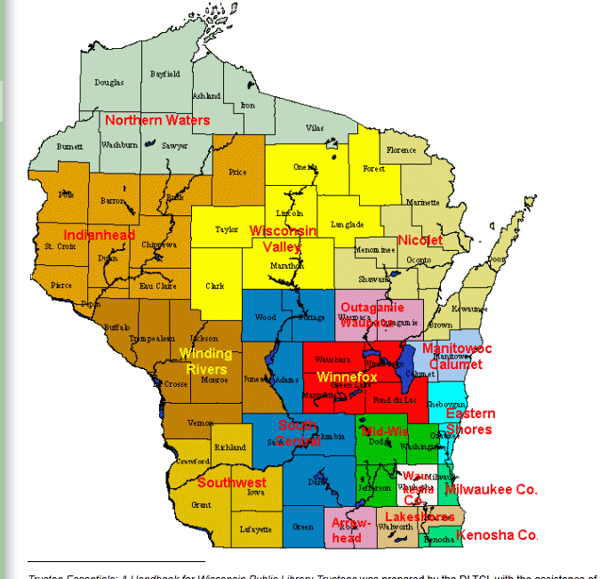
Resources
Library System Staff

Slide 38

Resources
Public Library
Development Team

Slide 39
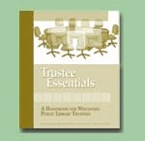
Resources
Trustee Essentials
Handbook

Slide 40


Question Time!

