Slide 1
Balancing at the digital tipping point
Libraries at the Digital Tipping Point
trends, impacts, and responses

Slide 2
“Now that there are e-books... People won’t need libraries any more”
Notes:
I’m sure you’ve all heard this at one time or another…..
Stef

Slide 3
What is the library brand?
Notes:
What is the first thing you think of when you think of a library?
In two studies conducted in 2005 and 2010, people identified books as the first thing they think of when they think of a library. I would bet that would still be true today.
Long standing, proud tradition of promoting reading and books.
How do libraries maintain and extend that brand in times of ebooks?
In addition, how do we as libraries go beyond that brand?
Example: Tiffanys – started as a stationary store, jewelry on the side – possible to shift brands, to refocus and retool. We’re going to talk about that tonight.
First, though, I’d like to talk about some trends related to the physical library and also some trends related to mobile device adoption because both of these will have an impact on this brand shift
Stef

Slide 4
Physical Library Trends
Notes:
Stef

Slide 5
Preliminary 2012 numbers
5
46,420
Notes:
Stef

Slide 6
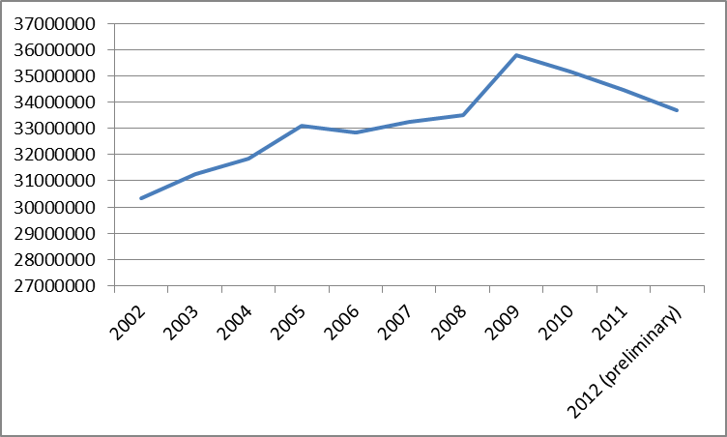
Library Visits
Notes:
This slide is the number of library visits in Wisconsin through 2012. You can see this trend is on a downward slope? Why? Is it because of the movement to digital resources? Let’s see……
Stef

Slide 7
Physical circulation
Notes:
The trend for physical circulation is flat, but not down as steeply as library visits……what else might explain it?
Stef

Slide 8
Open hours
Notes:
How about open hours? Looking at just the shape of the curve, you can see it really isn’t similar. Probably not accounting for the downward turn.
Stef

Slide 9
Library Visits & ???
Library Visits
????
Notes:
There is a very similar curve to this line…..it’s the Bureau of Labor Statistics unemployment data for Wisconsin.
We’ve all heard that libraries are used more in time of recession. Seems to be true!!
Think, though, what that might mean: we certainly don’t want a recession to continue. But, as we are on this cusp of the move to digital, there is this factor that will mean fewer people using libraries.
Stef

Slide 10
Mobile Trends
[PHOTO]
Notes:
Mobile trends are changing the way people do things traditionally associated with libraries, from reading to finding information.
In early 2000s, the libraries started working with ebooks and ereaders, and it really didn’t take off. Why now? Because people are using these devices to do everything!
Stef

Slide 11
87%
Mobile phone ownership in US, December 2012:
Source: Experian Simmons, late 2011
Source: Pew Internet, Mobile
Notes:
Mobile phone ownership in the United States in December 2012 – adults
Stef

Slide 12
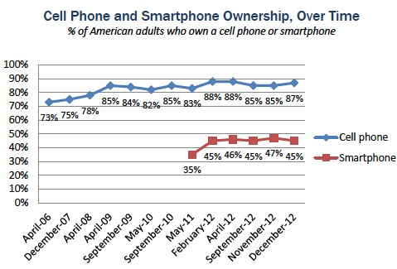
Source: Pew Internet, Mobile
Notes:
This chart shows the ownership of smart phones compared to total cell phone
Interestingly, as of April 2012, 17% of all adult cell owners who are “cell-mostly internet users”—that is, who use their phone for most of their online browsing.
Stef

Slide 13
What did you do in the last 30 days? (All cellphone owners)
Source: Mintel/Experian Simmons
Notes:
Ther has been a HUGE jump in what people are doing with their phones from 2007 to March 2012. Lots of email and web browsing. October 2010 was really the beginning of using WiFi on phones. It’s evidence of people doing more on their phones and the lack of unlimited data plans. Growth continues!!
Stef

Slide 14
Tablets vs Smartphones
Source: Adobe -- Tablets trump smartphones in global website traffic
Notes:
Why?
People prefer to do more in-depth tasks with their tablets than their phones
All countries saw tablet growth double in the last year
Many of these tablets are using WiFI – NOT cellular. One analyst, Chetan Sharma, said it was as high as 90% in 2012! They are dependent on wireless networks, at homes and at other places---like libraries.
Smartphones and tablets do not seem to be competing. Smartphone owners own more tablets and also are more likely to buy a tablet in the future.
Stef

Slide 15
Source: Goodreads, http://www.goodreads.com/blog/show/410-what-s-going-on-with-readers-today-goodreads-finds-out
Notes:
Stef

Slide 16
Source: Goodreads, http://www.goodreads.com/blog/show/410-what-s-going-on-with-readers-today-goodreads-finds-out
Notes:
Stef

Slide 17
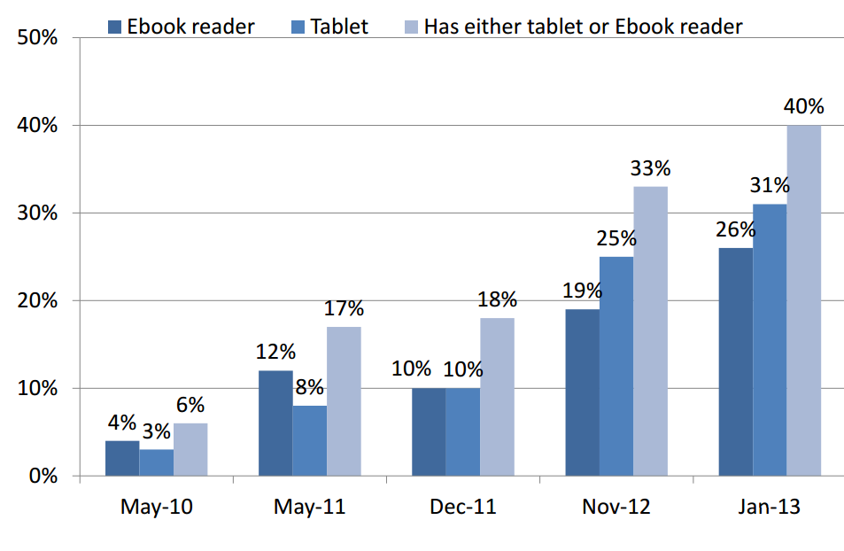
E-reading device distribution
Source: Pew presentation to ALA (complete link in “further reading”)
Notes:
Stef

Slide 18
Mobile users of library services
Source: Pew Presentation to ALA (see further reading for complete link)
Notes:
Stef
Sara next

Slide 19
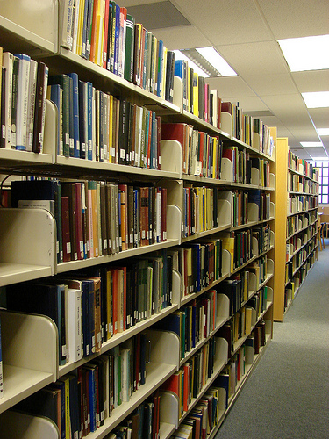
Extending the book brand
http://www.flickr.com/photos/barbourians/5365888653/in/photostream/
Notes:
Sara

Slide 20
75%
Percentage of American adults who read a book in previous 12 months (December 2012):
Source: Pew
Source: Pew Internet E-book reading…
Notes:
SG

Slide 21
Percentage of American Adults who read an ebook in the past 12 months
December 2011
November 2012
21%
30%
Source: Pew Internet E-book reading…
Notes:
SG

Slide 22
12%
Percentage of ebook readers that have borrowed one from the library:
Source: Pew
Source: Pew, 2012 on e-reading
Notes:
Lots of potential for growth!!
{Can’t find anything more recent than June 2012….}
SG

Slide 23
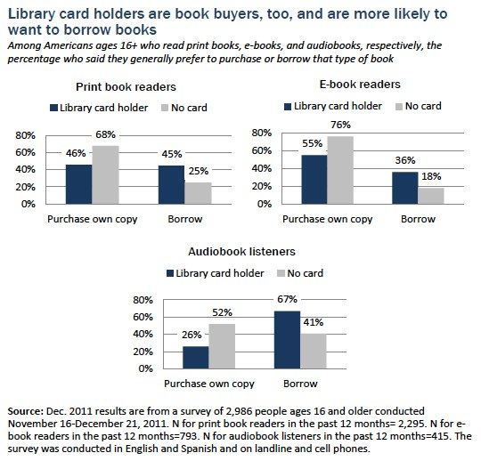
Notes:
When we look at who is buying books and who is borrowing books we can see:
Library card holders are book buyers as well as book borrowers.
Two things: 1) ebook readers tend to overwhelmingly purchase ebooks at this point which could be due to lack or awareness that the library offers ebooks or long hold lists.
2) 61% of… audiobook users prefer to borrow them. This could point to a good growth space for libraries!
SG

Slide 24
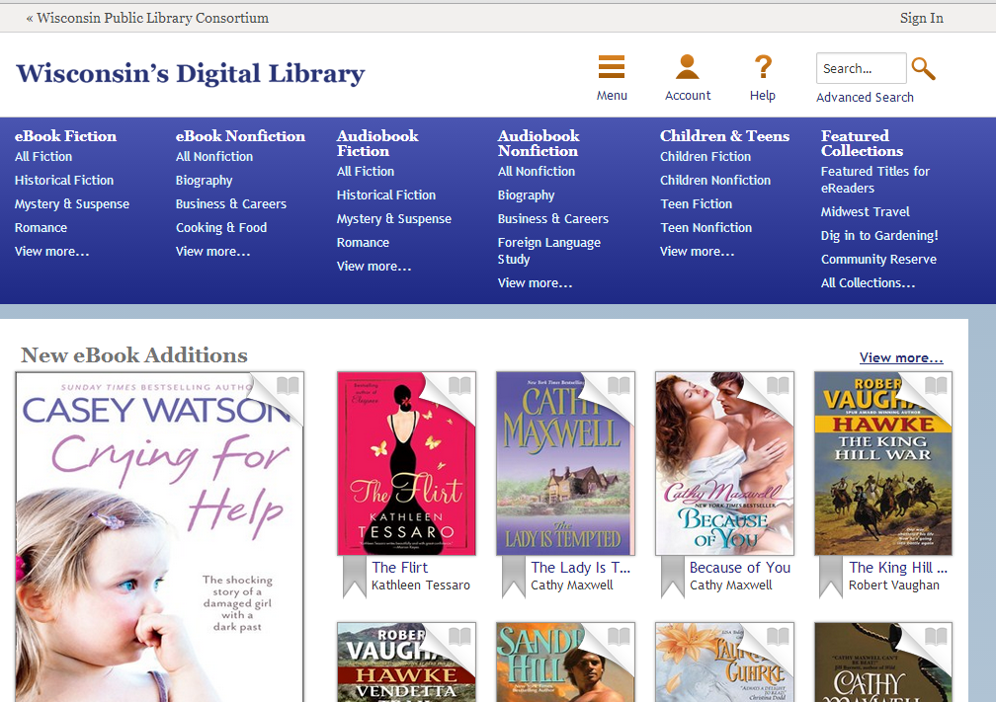
WPLC digital library
Notes:
How are Wisconsin libraries capitalizing on this trend?
By working together to create the Wisconsin’s Digital Library
This library of over 88651 copies of over 35947 unique titles includes 11,666 copies of 4940 unique titles in Advantage system libraries.
Audio: 11783 titles, 20472 copies
eBooks: 23569 titles, 67672 copies
We add ~3000 titles per month, 500 are audio
As of today, this ebook collection is larger than the print collection about 270 of the public libraries in the state
In 2013 (and in future years), the libraries have pooled their resources to spend $1 million on content.
We spend ~ $80,000 per month $21,000 is on audio rest is on ebooks
This collection has the 3rd largest circulation in the country. It’s growth has been mammoth…..
SG

Slide 25
OverDrive circulation
Notes:
There is no denying the growth of OverDrive circulation.
Based on the actual use of the first 5 months of 2013, averaged out, assuming no additional growth, we will have almost 2 million checkouts in 2013
August – December 2012: 564,641
January – May 2013: 819,020
45% increase. This is actually slowing: 64% increase late last year.
We are #3 in the country in registered users, #2 in checkouts, but #13 in size of collection….which could explain why we are #1 in holds!!!
Currently have 64,447 unique users with titles checked out.
Checkouts
Audiobook 1,537,317 (11,237 current)
eBook 1,703,336 (45,473 current)
Music 15,062 (13 current)
Video 21,113 (47 current)
Total 3,276,828 (56,770 current)
Holds
Audiobook 864,349 (13,923 current)
eBook 1,290,075 (55,283 current)
Music 2,633 (1 current)
Video 5,532 (5 current)
Total 2,162,589 (69,212 current)
SG

Slide 26
OverDrive and total circulation
Notes:
Right now, you can see that OverDrive circulation is hardly a blip. But, as physical circulation flattens or declines, and OverDrive circulation increases exponentially, it won’t be long before it is more than a blip.
Print is still king, but there is no denying (as illustrated by the previous slide), the uptake of digital.
SG

Slide 27
Formats in OverDrive & Circulation
Notes:
Here are the various formats of content we have in OverDrive, along side circulation. The Kindle, while second in the number of titles/copies, is the highest in circulation.
Just to note: We don’t buy all of these formats individually. We get titles in different combinations of formats as bundles. For example, a title may be purchased, and we would get the Kindle and PDF versions together. So, while the PDF versions don’t circulate as well, we don’t save money by not “buying” that format.
SG

Slide 28
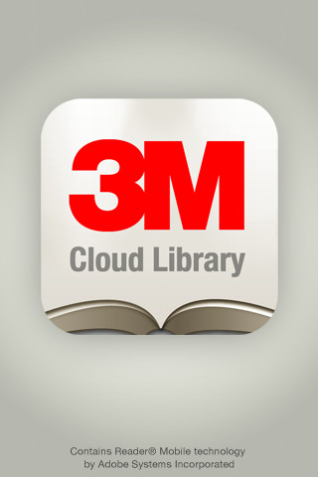
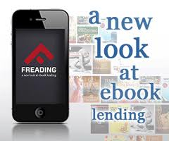
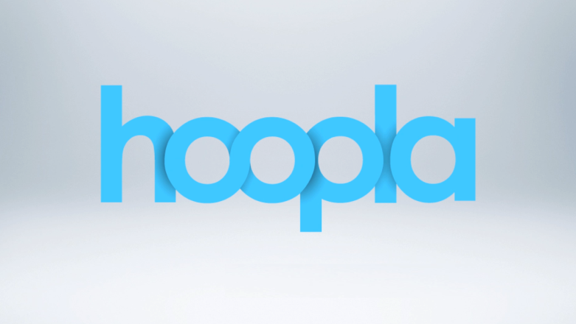
Plethora of Content Providers
Notes:
Right now, this digital library uses OverDrive as its vendor.
But there are a plethora of other vendors out there that all do different things with ebooks and digital audiobooks.
The digital library will include other vendors as is appropriate, but so far, the committee that evalutes this has not found anything that matches the selection and flexibility of OverDrive.
SG

Slide 29
Open Content Projects
Notes:
Library Renewal is a grassroots not for profit formed in 2010 to further the mission of libraries as it relates to electronic content. They are working to create and access and distribution system for econtent that would allow libraries to dictate what they pay for content
WiLS is working on research into open content projects around the country. We will present our findings to the WPLC Board.
SG

Slide 30
Libraries as Publishers
Notes:
Mark Coker, founder of Smashwords, which is the world's largest distributor of indie ebooks. It’s a free and easy way for any author or publisher to publish and distribute ebooks to the major retailers.
Public libraries are at a crossroads with the rise of ebooks.
Some book publishers, fearful that library ebook lending will cannibalize retail sales of books, are reluctant to supply ebooks to libraries at the very time that library patrons are clamoring for greater access to such materials.
Some libraries see an opportunity to take control by proactively cultivating a newer, more library-friendly source of ebooks. These libraries are developing community publishing initiatives in partnership with self-published ebook authors.
Other self-publisher distributors:
AuthorSolutions
ePub Direct
Perseus Book Group
Source: http://www.huffingtonpost.com/mark-coker/library-ebooks_b_2951953.html
SG

Slide 31
PDA in Libraries
Notes:
SG

Slide 32
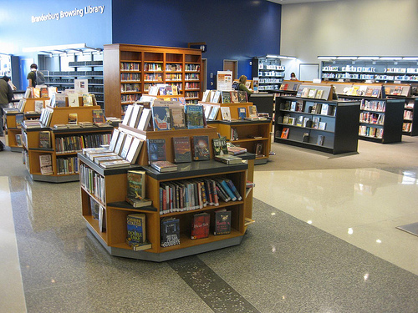
Change in physical spaces
Notes:
Notes from a discussion with Anders Dahlgren, Library Planning Associates:
Think about our spaces as they are now: the focus is on control, circulation desk is at the front, blocking in and out.
Think about retail experiences that are similar: Walmart, grocery stores, other warehouse-oriented stores.
Think about retail experiences that are designed to be about the experience: the Apple store, other boutique retail. You never see the checkout counter at the front of the store. The store is designed to get you experiencing the merchandise as soon as you walk in.
We can engage people in books and reading in the same way.
There has been a lot of press lately about “showrooming” – where people go into stores, try out stuff, then go buy it online. This is a good thing, potentially for libraries!! “showrooming” content in the sense of borrowing or browsing to buy, showrooming equipment, etc.
The picture on the left is of the San Jose Public Library browsing library…doesn’t even look like a library, does it? Has a definite bookstore feel
The picture on the right is the James B. Hunt library at North Carolina State. It’s an academic library, but I thought the integration of collection and seating is a nice illustration of the changes in space
As we shift to digital, it may be less for the patron about finding a specific book on the shelf and more about the discovery that browsing (and recommendations from libraries!) allows.
SG

Slide 33
Challenges to extending the book brand
Notes:
SG

Slide 34
Not all of the 6 major publishers will sell to libraries….consortia
Notes:
--For the longest time, was only two publishers
Macmillan: one imprint, Minotaur but not to consortia, all audio
S &S: one ebook, Fahrenheit 451, no audio
Penguin: No new audio or ebooks prior to Feb 2012 via OverDrive 6 month embargo on new books, 1 year expiration on all titles, only available through 3m
Hachette: All ebooks not to consortia , most audio
HC: Yes
RH: Yes
-Starting to see the conversation increase
--Looking for models that work
--Harper Collins example: $1.20per circ for Harper Collins titles compared to $1.34 for overall ebook circ cost
SG

Slide 35
Looking for content
56%
30%
56%
Source: Pew
Notes:
56% -- This is the percentage of e-book borrowers who found a book that they wanted to read wasn’t available through the library.
30% -- couldn’t find anywhere
Imagine what our circulation could look like if we could get all of the content!!!
Pew
SG

Slide 36
Government Intervention
Lawmakers are calling for a study of the availability of e-books to Connecticut public libraries.
Source: http://www.wtnh.com/dpp/news/politics/conn-bill-would-study-library-access-to-e-books#.UazZUpyt-19
Notes:
SG

Slide 37
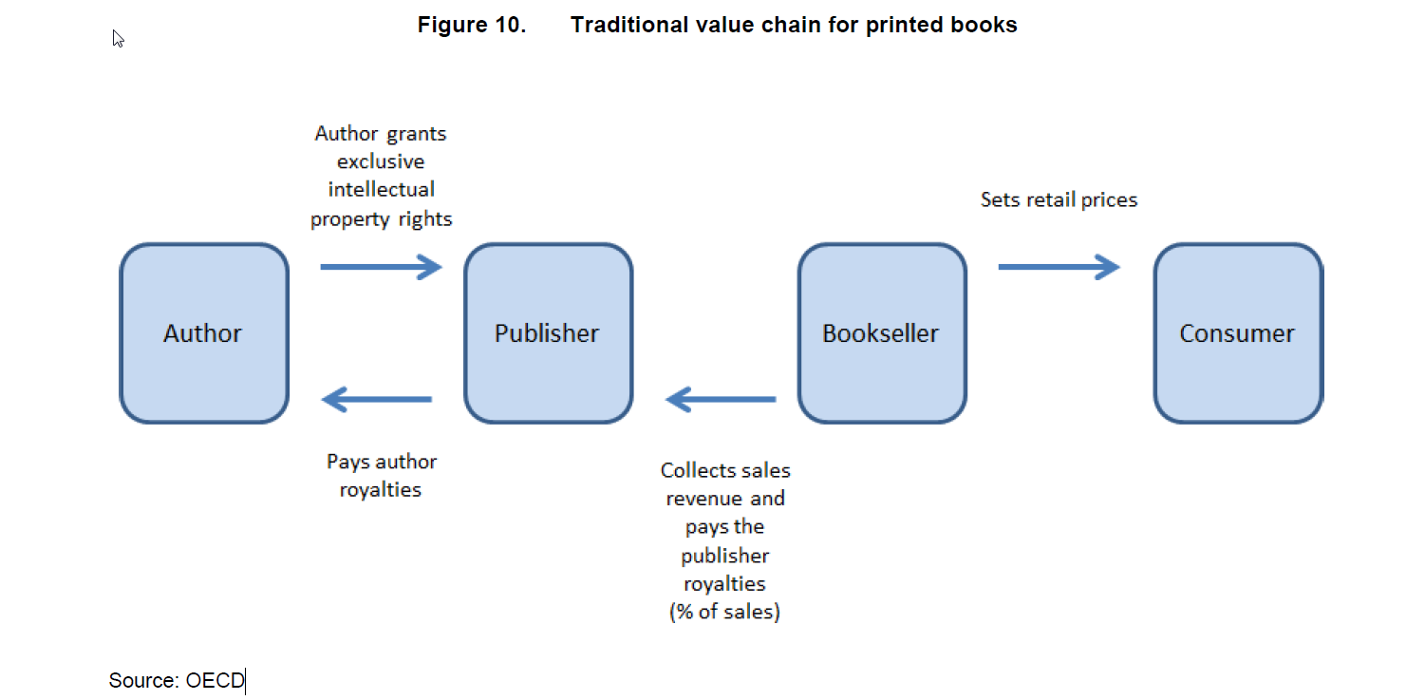
Notes:
To understand the way ebooks are currently priced i.e all over the board) it helps to understand the traditional pricing model for printed books.
Known as the wholesale model, the author grants the publisher exclusive IP rights and the publisher pays royalties to the author (17-20 %) of sales distributor gets books for 55-65% off retail and sells to booksellers at 45-55% off retail. Booksellers can then mark down books at their discretion from SRP
Publisher handles selection of works
Printing, advances to authors
Organization of distribution
SG

Slide 38
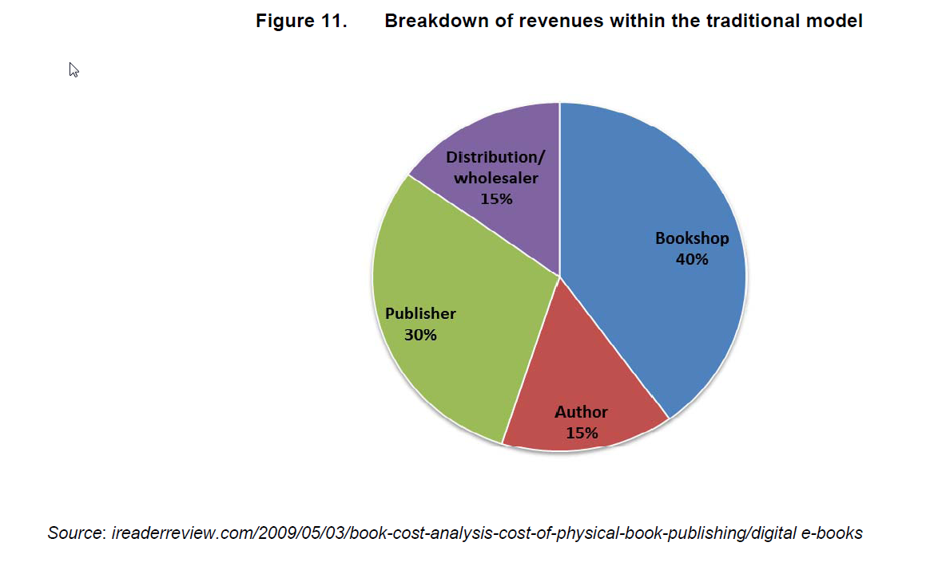
Notes:
Here’s the breakdown of revenue. Remember retailers can determine the discount they pass onto their customers.
The bigger the bookstore the larger the discount that can be given
The battle to increase market shares by deep discounts led to the growth of giant bookselling chains and…next slide
SG

Slide 39
The 800 lb Gorilla
Notes:
SG

Slide 40
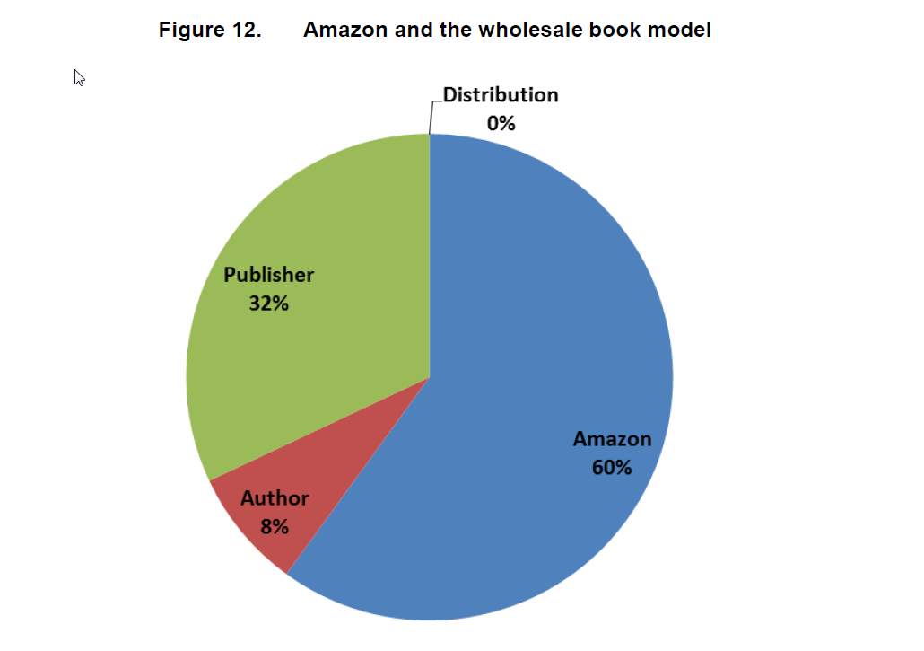
Source: OECD
Notes:
Amazon was able to cut out the distributor and bookstore with it’s wholesale model, taking those % for itself.
Immediately following the Kindle’s launch from 2007-2009, Amazon succeeded in capturing 90% of the ebook market and 60% of the ereader market
SG

Slide 41
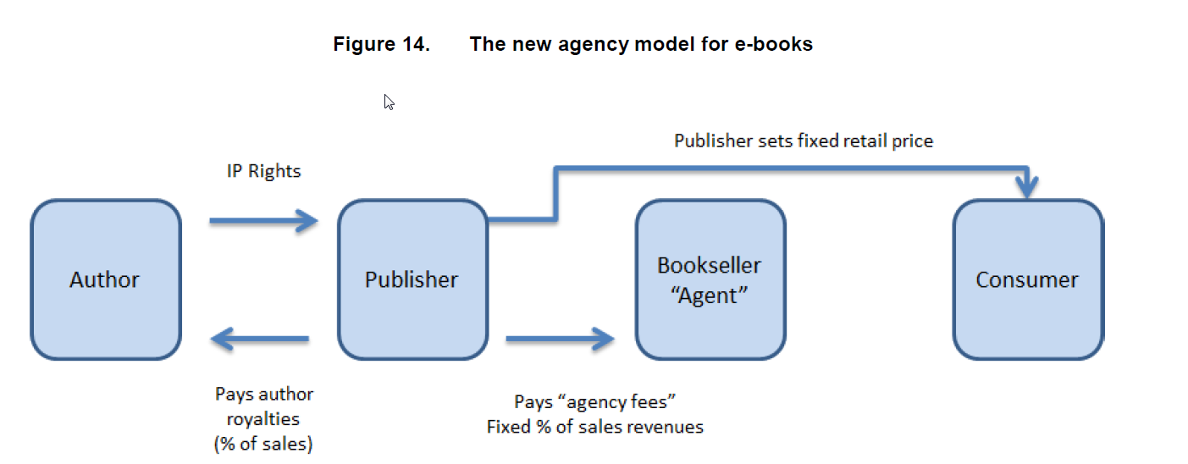
Notes:
When Apple entered the ebook market, it offered a new type of pricing model, called the agency model which allowed publishers to set their own prices for books.
Although publishers still receive roughly the same % (30) of the pie, by increasing prices they increase the amount of revenue they receive.
Publishers are in control with this model as they can set ebook prices in a way that doesn’t take away from print sales.
Consumers, particularly libraries lose out by paying more.
SG

Slide 42
Lownership
Notes:
What if we could design a hybrid model
Ownership of local content and leasing bestsellers?
SG

Slide 43
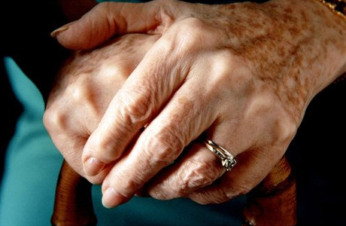
Underserved
Notes:
It is important to consider those people who run the risk of being under-served with regards to ebooks.
Low income is the greatest risk factor in determining who is underserved.
Age is another factor, senior citizens in particular may be fearful of new technology, perceived steep learning curve particularly if this is their first exposure to a touch screen and/or mobile device.
Visually Impaired –ereaders are not equipped with voice technology to help guide a V.I. person to load books on the device.
Android has severe screen reader accessibility problems. For example, its default browser and email program are not available to TTS.
Keep in mind that underserved patrons often are a silent majority.
http://aim.cast.org/learn/e-resources/accessibility_resources/ebooks_ereaders
SG

Slide 44
Donations & sharing
Notes:
Libraries have always operated on the “right of first sale”
I buy the book, I can do what I want with it. I can share it with all of you, etc.
In the new ebook world, this is no longer true.
We sign license agreements for these books. We can’t just circ them any way we want. (queue picture a minute ago)
Same thing is true with donations….
You buy book, you give book to library. Library sells book.
Donations are a big part of a library’s world currently.
Hear time and time again how someone would like to donate to our collection.
“I got this Kindle edition…..”
Sadly, the answer is NO.
Donate money through WPLC
SG

Slide 45
Impact on resource sharing
ebooks from most publishers and vendors take away some of the rights that are inherent in print books.
Notes:
Print books can be shared between patrons, libraries and library systems. Ebooks cannot in the current public library model. Important note: Academic ebook programs do allow a variety of ILL rights.
We are fortunate we have a shared collection of ebooks statewide as everyone with a public library card can access. If this goes away we will see a division in the systems with funding being able to collect materials and systems without, missing out.
SG

Slide 46
Frustrations with the products
Notes:
Digital providers are continuously refining their products. The newest format refinement from OverDrive
is the introduction of streaming audiobooks. Patrons will be able to “see book- hear book” without long downloads.
Also the apple device users will be able to listen to many more titles as they will no longer be tethered to the mp3 format.
Less formats = Less frustration
Also: frustration with multiple interfaces for physical and digital collections: Our ILS systems are primarily designed to manage physical resources. How do we make it easy for patrons to discover both print and digital? (Right now, we treat them differently). How can we make it easy for patrons to place holds the same way, for library staff to troubleshoot hold and wait list issues the same way? We need to build systems to integrate.
SG

Slide 47
57%
Are public libraries loaning e-books?
…..didn’t know
Source: Pew
Notes:
Lack of awareness is big……
Used to be 63%; In January, 57% -- so getting better!
In general with library programs:
--31% of Americans said they know not much or nothing at all of what their libraries offer (Pew report on library service in the digital age)
SG

Slide 48
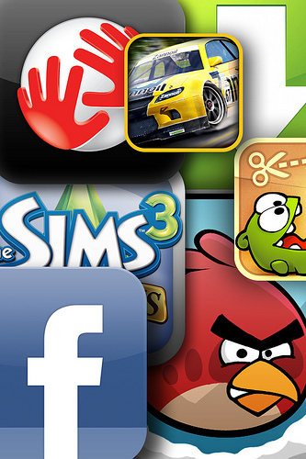
Distraction!
“Tablets will adversely affect the e-book business in that the tablet is a multifunction device and will therefore draw the reader into non-book activities and therefore cause them to consume books slower …”
http://www.forbes.com/sites/jeremygreenfield/2012/08/14/the-new-tablet-reality-for-e-books-will-readers-read-less/ http://www.flickr.com/photos/42324406@N04/5149839681/
Notes:
SG

Slide 49
Impact on staffing & training
Notes:
We need to understand the formats and the devices to do extend the brand into the world of ebooks
The Pew report revealed some elements of successful staff training in ebook devices:
--The instruction is hands-on and not theoretical.
--Staff has the opportunity to practice at home with the devices.
--Staff share their experiences and learning with one another.
--The staff is encouraged to own devices through purchasing incentives or other means.
Getting staff comfortable with training patrons on devices is another challenge for us.
Not sure where to begin with training? OverDrive has a great service that provides almost everything you need to train both staff and patrons. All you provide are the devices (which OverDrive can help you select if you would like)
Users borrow your Test Drive devices to download eBooks from your digital collection. When a device is returned, OverDrive provides guidelines to help you reset it for the next user.
This way, even people who don’t own devices of their own have the opportunity to learn how to use them while increasing circs and following publisher copyright
SG

Slide 50
How are YOU extending the book brand? (or how would you…)
Notes:
This is a time for them to share: ideas, what they are already doing, other examples they have seen….
SG

Slide 51
How are YOU extending the book brand? (or how would you…)
Goodreads membership for Manitowoc PL; staff members use it (for patrons, set up for readers advisory, with discussion threads, “what we’re reading?”) – could create ebook lists or other format lists
At service desks, there are ipads for staff to play with and learn: a way for staff to practice.
Lots of circulating readers (Kindles), one circulating tablets in-house
Kindle & OD records in catalog
Ebook training sessions – bring devices, drop-in for one-on-one training or appointments (for other tech, too) –
Digitization projects: photo collections which led to an ebook!
Advocating for the staff to talk more about the books, genre studies (list of people on the team pick a book and talk about them)
Clips with titles of books in series
Notes:
We add their ideas…..
SG

Slide 52
Extending BEYOND the book brand
Notes:
Stef

Slide 53
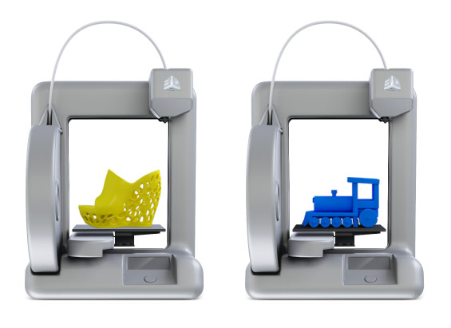
Pooling resources…
Notes:
This is what libraries have always been about, right? Pooling resources to buy stuff that people can’t afford on their own. Pooling for the common good…..there are some new directions for this type of pooling of resources:
The picture on the left is a 3-D printer from Cubify. 3-D printers and other high-end production facilities are things that libraries can buy that individuals may not be able to afford: podcasting and video production, etc. Fayetteville Public Library in NY is a great example. They have started a “FabLab”, which is not just 3-D printers, but all sorts of tools to create a “re-write” culture in their community. They are urging patrons to consume information and use it to create something new: make your own book programs for kids, etc. Sauk City Public Library here in Wisconsin has one.
Collaboration stations: this picture on the right is a multi-computer collaboration table that is – again – something people won’t have access to at home. It’s an opportunity for students, small business folks, etc. to work together in the library space.
Of course, with both collaboration and fabrication, there are opportunities for supporting programming…..
Stef

Slide 54
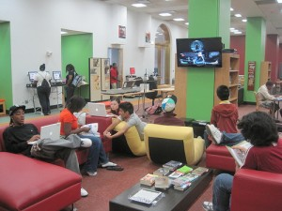
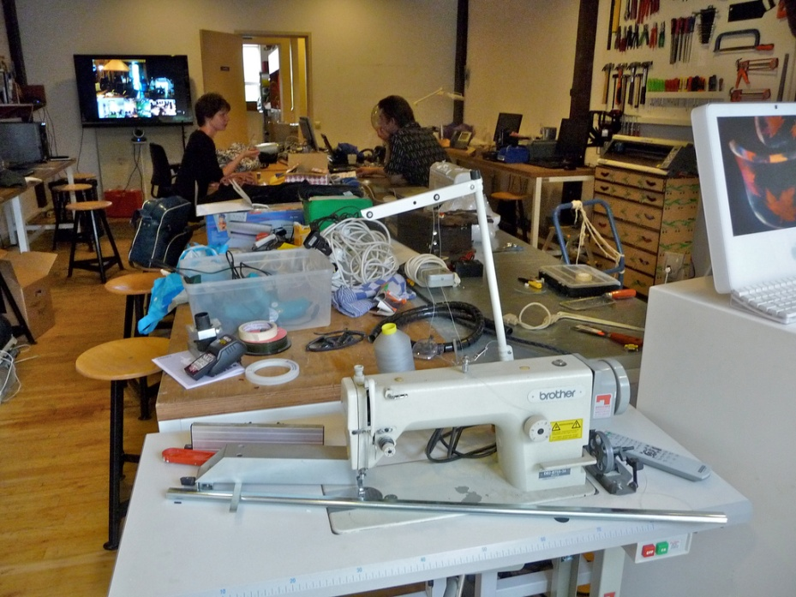
Changes in physical space
Notes:
Goes beyond just buying stuff…..change in entire atmosphere
Bottom one is the James B. Hunt library at North Carolina State
…and related training and staffing and philosophy!
Recent post by Lorcan Dempsey talks about “Library Space as Service” -- “A shift is underway in library space, from being configured around collections to being configured around research, learning and related social behaviors. In this way, space is an important aspect of how a library engages with its users; it is a service in itself, not only part of the infrastructure to manage collections.”
Along with this, he talks about the need to consider “full library discovery” – full discovery of all services – beyond just the “full collection discovery” we’ve aimed for in the past.
At Brooklyn Public Library’s New Center, books are secondary to tech-ready meeting commons.
http://cityroom.blogs.nytimes.com/2013/05/09/at-brooklyn-librarys-new-center-books-are-secondary/?src=recg
Stef

Slide 55
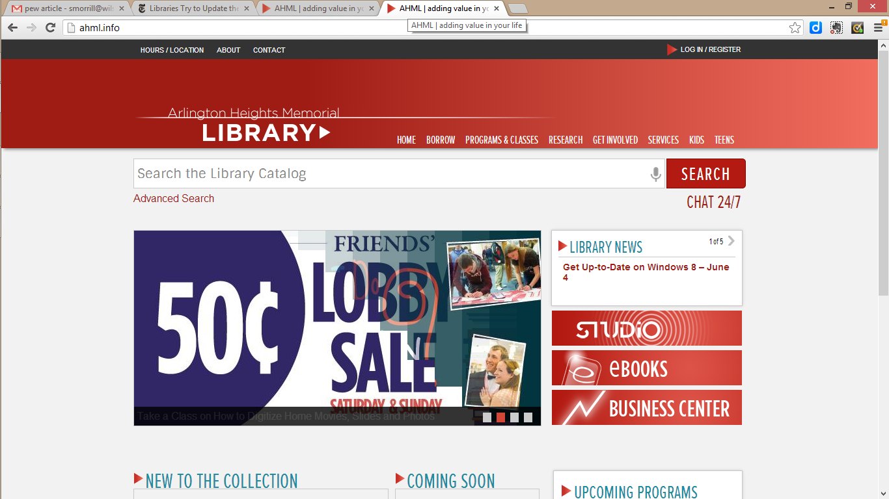
Full library discovery (cont.)
http://ahml.info/
Notes:
Stef

Slide 56
Two facts to consider
76% of Americans say quiet study spaces are a “very important” service
77% say free access to computers and the internet is a “very important” service
Source: Pew Presentation to ALA (see further reading for full link)
Notes:
Stef

Slide 57
If you build it, will they come?
Source: Pew presentation to ALA. Complete link in “Further Reading”
Notes:
--Percentages go up with Latino/African American populations and parents {Parents are theme throughout this report}
Stef

Slide 58
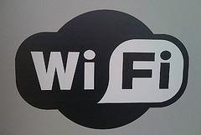
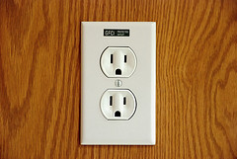
Changing technology in the library
Notes:
--Over half the tablets sold have been sold without WiFi
--Phones are getting cheaper, but data plans are getting more expensive
55% of tablet owners report using WiFi in places other than home.
First and most obviously……wifi will be an essential service for these mobile users. They will be looking for ways to avoid using those expensive data plans…and the library can help!
In the Wisconsin user/non-user study, only 53.2% of respondents said that their library offered wireless internet. We have a huge opportunity for promotion of this service!!
In this same survey, it was found that the general perception of the library decreased with each generation. So, Gen Yers had the least favorable impression of the library. 24.8% of them would enhance the wireless access at libraries.
We have to be careful to treat wifi as a core service, not something that can be down for a while without anyone noticing.
POWER: library as a community gathering place, a place to read or work or whatever
What will the long-term impact of mobile devices on our computer labs?
In 2011, in Wisconsin, the number of computers users at the library dropped again.
However, roughly 30% of Baby Boomers and Gen Xers wanted the library to add more computers.
Will we need to maintain rows and rows of computers for basic web surfing? Or will we be able to focus our energy on high-end creation stations and lots of places to charge devices?
Should we be getting into the business of circulating devices in the library?
The mediasurfer (on the right) can check out iPads and wipe them clean when they are returned. Will these eventually be replacements for those basic web surfing computers?
Stef

Slide 59
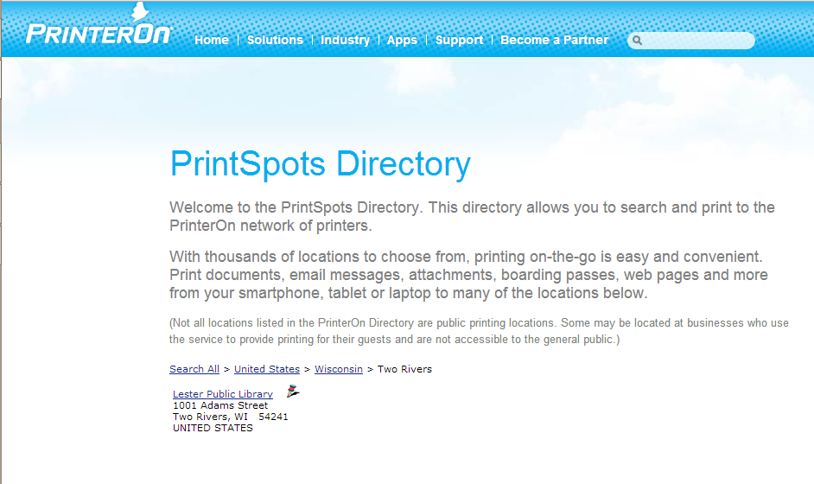
A little more changing tech…
Notes:
This is a wireless printing service that people can use to identify wireless printing in their area.
Stef

Slide 60
Source: WPLC user/non-user survey, 2012
Notes:
Stef

Slide 61
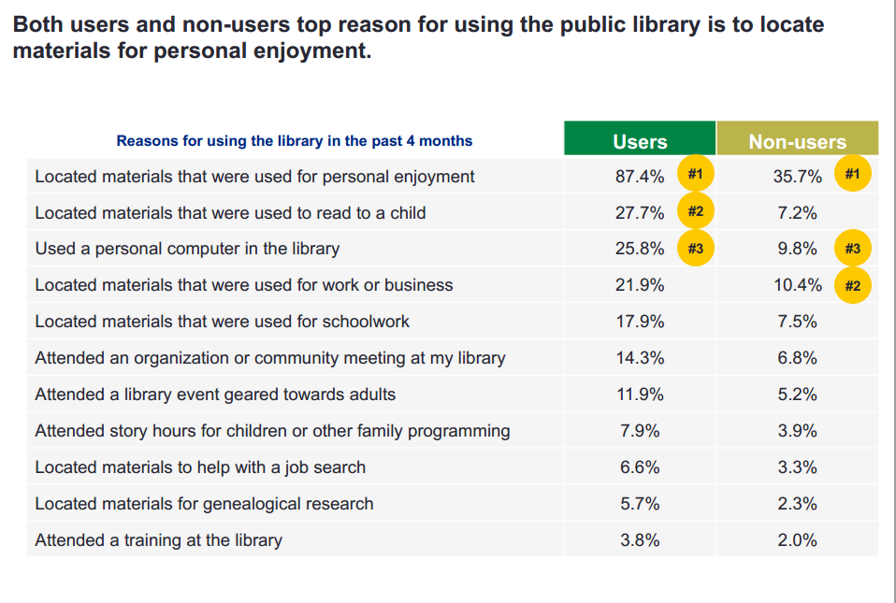
Source: Pew presentation to ALA

Slide 62
Program attendance
Notes:
Program attendance is up…..despite visits being down
Increase number of programs, increase number of attendees
Programs to extend book brand – go beyond?
Maker space, technology,
Stef

Slide 63
An example: La Crosse Seed Library
Video
Notes:
Stef

Slide 64
Idea Store…
Notes:
Focus is on education, partnerships, community
Stef

Slide 65
Partnerships & education…..
Source: Pew presentation to ALA. Complete link in “Further Reading”
Notes:
Among other things!!!
Stef

Slide 66
An example of a partnership….
Notes:
Everyone On is a great example of a partnership related to literacy – in this case, digital literacy
Helps people find classes and free wireless internet access…..supports the themes we’ve been talking about related to awareness and technology and training – why not participate?
Stef

Slide 67
Impact on information-seeking and reading behaviors
There is growing evidence that the "digital divide"--the focus on access to technology--is less of a challenge than the "participation gap"--the focus on the skills, competencies, and knowledge networks that young people develop.
Source: Watkins, S Craig, "The Young and the Digital: Exploring the Shifting Contours of Young People's New Media Practices“, 2012
Notes:
Immediate impacts will be a growing expectation of instant access with a frictionless experience. Patrons could experience frustration with waiting lists for digital materials as they expect them to be available widely and immediately.
A longer term impact will be found in research on info-seeking behaviors that seems to suggest that the future will reveal a shift from the “digital divide” to a “participation gap” particularly in areas of the acquisition of info-seeking skills, information literacy and knowledge networks.
Will young adults be able to find, evaluate and disseminate information the way they need to, to be successful?
Stef

Slide 68
How are YOU extending beyond the book brand? (or how would you…)
Notes:
This is a time for them to share: ideas, what they are already doing, other examples they have seen….
Stef

Slide 69
How are YOU extending beyond the book brand? (or how would you…)
Partnering with UW Manitowoc
Local History Alive program
Great Decisions Partner Series-topics paired with scholars
Learning in Retirement: present catalog classes, genealogy, videos created and then shared
Bringing in new base of users through partnerships
Offering library as a place/sponsor for gardening club and other orgs
Use of social media to promote partnerships
Toy library: for check out
Watt Meters
Notes:
Stef

Slide 70
Some questions to consider….
What is the cost of doing it? (in time and money and in lost opportunities and reputation)
What is the cost of NOT doing it? (in time and money and lost opportunities and reputation)
Do YOU need to do it? (or can someone else – in the community? At a consortium level?)
What are the partnership opportunities?
Does it advance your mission?
Notes:
Stef

Slide 71
Further Reading
Pew Internet Report: Libraries, Patrons and E-Books http://libraries.pewinternet.org/2012/06/22/libraries-patrons-and-e-books/
Pew Internet Report: The Rise of e-Reading http://libraries.pewinternet.org/2012/04/04/the-rise-of-e-reading/
Presentation of Pew report “Library Services in the Digital Age” to ALA: http://www.pewinternet.org/~/media//Files/Presentations/2013/Greatest%20hits%20libraries_ALA%20legislative%20action%20day_PDF.pdf
What is the Role of Libraries in the Age of Ebooks? http://www.pbs.org/mediashift/2012/05/what-is-the-role-of-libraries-in-the-age-of-e-books-and-digital-information122.html

Slide 72
Further Further Reading
Two things prompted by a new website: space as a service and full library discovery http://orweblog.oclc.org/archives/002202.html
OECD (2012), “E-books: Developments and Policy Considerations”, OECD Digital Economy Papers, No. 208, OECD Publishing. http://dx.doi.org/10.1787/5k912zxg5svh-en
ALA's New "Ebooks & Digital Content" Site http://www.ala.org/transforminglibraries/ebooks-digital-content
Tablets trump smartphones in global website traffic: http://blogs.adobe.com/digitalmarketing/digital-index/tablets-trump-smartphones-in-global-website-traffic/?utm_source=WhatCountsEmail&utm_medium=OCLC%20Abstracts%20Test%20Group%203&utm_campaign=OCLC%20Abstracts

Slide 73
Further Further Further Reading
Pew Internet: Mobile {January 2013 update} http://pewinternet.org/Commentary/2012/February/Pew-Internet-Mobile.aspx Pew Ebook reading article: http://libraries.pewinternet.org/2012/12/27/e-book-reading-jumps-print-book-reading-declines/
Ebooks in 2013: Promises Broken, Promises Kept, and Faustian Bargains, by Clifford Lynch http://viewer.zmags.com/publication/7d9e3366
How Libraries Can Launch Community Publishing Initiatives with Self-Published Books by Mark Coker http://www.slideshare.net/Smashwords/how-libraries-can-launch-community-publishing-initiatives-with-selfpublished-ebooks

Slide 74
Thanks!
Sara Gold: sgold@wils.wisc.edu
Stef Morrill: smorrill@wils.org

